Slide 1

Microprocessor and Computer Architecture Addressing Modes

Slide 2

Addressing Modes
The term addressing modes refers to the way in which the operand of an instruction is specified.
The addressing mode specifies a rule for interpreting or modifying the address field of the instruction before the operand is actually executed.
Addressing modes for instructions are divided into two categories:
1) Addressing modes for data
2) Addressing modes for branch
The addressing modes provide flexible access to memory, allowing you to easily access variables, arrays, records, pointers, and other complex data types.
The key to good assembly language programming is the proper use of memory addressing modes.
An assembly language program instruction consists of two parts: Opcode and Operand.

Slide 3
Addressing Modes (Contd..)
IMPORTANT TERMS
Address Field: Address field may designate a memory address or a processor register.
Starting address of memory segment.
Effective address: The effective address is defined to be the memory address obtained from the computation dictated by the given addressing mode. The effective address is the address of the operand in a computational-type instruction.
Offset address: An offset is determined by adding any combination of three address elements: displacement, base, and index.
Displacement: It is an 8 bit or 16-bit immediate value given in the instruction.
Base: Contents of base register, BX, or BP.
Index: Content of index register SI or DI.

Slide 4
Types of Addressing Modes
Addressing Modes based on Data
Implied Addressing Mode
Immediate Addressing Mode
Register Direct Addressing Mode
Register Indirect Mode
Auto Indexed (Increment Mode)
Auto Indexed (Decrement Mode)
Absolute Addressing Mode
Indirect addressing Mode
Addressing Modes based on Transfer of Control
PC Relative Addressing Mode
Base Register Addressing Mode
Indexed Addressing Mode
Base Indexed Addressing Mode

Slide 5
Addressing Modes Based on Data

Slide 6

Implied Addressing Mode
In implied addressing the operand is specified in the instruction itself.
In this mode the data is 8 bits or 16 bits long and data is the part of instruction.
Zero address instruction are designed with implied addressing mode.
For Example: CLC (used to reset Carry flag to 0), CMA, INC A, RLC, RAR etc.
Implied Addressing Mode pictorial format

Slide 7
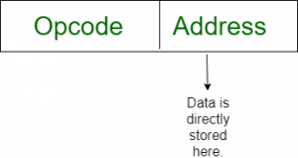
Immediate Addressing Mode (symbol #)
In this mode data is present in address field of instruction. Designed like one address instruction format.
This instruction has an operand field rather than an address field. The operand field contains the actual operand to be used in conjunction with the operation specified in the instruction.
These instructions are useful for initializing register to a constant value.
For Example: MOV AL, 35H (move the data 35H into AL register)
ADD AX, #5H (A=A+5)
LDA, #25H (Load 25H into the accumulator)
AND AX, 0000H (AX=AX^0000)
Note:
Limitation in the immediate mode is that the range of constants are restricted by size of address field.
No memory reference.
Fast execution.

Slide 8
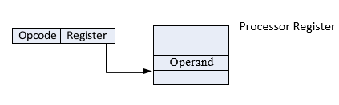
Register Direct Addressing Mode
In this mode, the operands are in registers that reside within the CPU.
The register is selected from the register field in the instruction.
For Example:
MOV AX, CX
ADD BL (AL=AL+BL)
Note:
Effective Address (EA) = R
Here one register reference is required to access the data.
No memory reference.
Limited address space

Slide 9
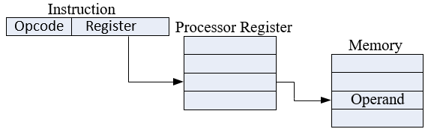
Register Indirect Mode
In this mode the instruction specifies a register in the CPU whose contents give the address of the operand in the memory.
In other words, the selected register contains the address of the operand rather than the operand itself.
Before using a register indirect mode instruction, the programmer must ensure that the memory address of the operand is placed in the processor register with a previous instruction.
For example:
MOV AX, [BX]
MOV AX, [DI]
ADD AL, [BX]
MOV AX, [SI]
Note:
Effective Address (EA) = (R) or [R]
Here two register reference is required to access the data.
Large address space.
The address field of the instruction uses fewer bits to select a register than would have been required to specify a memory address directly.
The CPUs let you access memory indirectly through a register using the register indirect addressing modes.

Slide 10
Auto Indexed (increment mode)
Effective address of the operand is the contents of a register specified in the instruction.
After accessing the operand, the contents of this register are automatically incremented to point to the next consecutive memory location (R1) +.
Here one register reference, one memory reference and one ALU operation is required to access the data.
Example:
Add R1, (R2) + // OR
R1 = R1 +M[R2]
R2 = R2 + d
Useful for stepping through arrays in a loop. R2 – start of array d – size of an element.

Slide 11
Auto indexed (decrement mode)
Effective address of the operand is the contents of a register specified in the instruction.
Before accessing the operand, the contents of this register are automatically decremented to point to the previous consecutive memory location. –(R1)
Here one register reference, one memory reference and one ALU operation is required to access the data.
For Example:
Add R1, -(R2) //OR
R2 = R2-d
R1 = R1 + M[R2]
Auto decrement mode is same as auto increment mode. Both can also be used to implement a stack as push and pop. Auto increment and Auto decrement modes are useful for implementing “Last-In-First-Out” data structures.

Slide 12
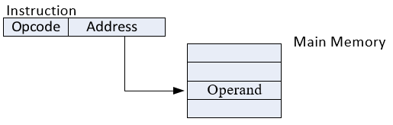
Absolute addressing Mode (symbol [ ])
In this mode the effective address is equal to the address part of the instruction.
The operand resides in memory and its address is given directly by the address field of the instruction.
Effective Address (EA) = A
For Example:
ADD AL, [0301H] //add the operand of offset address 0301H to AL
MOV AX, [0500H] //move the operand of offset address 0500H to AX
Note:
Here only one memory reference operation is required to access the data.
Simple.
Limited address Field

Slide 13
Indirect addressing Mode (symbol @ or ())
In this mode address field of instruction contains the address of effective address. Here two references are required. a) 1st reference to get effective address. b) 2nd reference to access the data.
Based on the availability of Effective address, Indirect mode is of two kinds:
Register Indirect: In this mode effective address is in the register, and corresponding register name will be maintained in the address field of an instruction.
Memory Indirect: In this mode effective address is in the memory, and corresponding memory address will be maintained in the address field of an instruction.
For Example:
MOV AX, (A)
ADD AX, @BX

Slide 14
Addressing Modes Based on Transfer of Control

Slide 15
PC Relative Addressing Mode
PC relative addressing mode is used to implement intra segment transfer of control. In this mode effective address is obtained by adding displacement to PC.
EA= PC + Address field value
PC= PC + Relative value.
Note:
Used for program control instructions

Slide 16
Base Register Addressing Mode
Base register addressing mode is used to implement inter segment transfer of control. In this mode effective address is obtained by adding base register value to address field value.
EA= Base register + Address field value.
PC= Base register + Relative value.
For example:
MOV DX, [BX+04]
ADD CL, [BX+08]
Note:
PC relative and based register both addressing modes are suitable for program relocation at runtime.
Based register addressing mode is best suitable to write position independent codes.
The base register addressing mode is used in computers to facilitate the relocation of programs in memory i.e., when programs and data are moved from one segment of memory to another.

Slide 17
Indexed Addressing Mode
The operand’s offset is the sum of the content of an index register SI or DI and an 8 bit or 16-bit displacement.
For example:
MOV AX, [SI +05]
ADD AL, [DI+16]
Note:
1) Use to access or implement array efficiently.
2) Multiple registers required to implement.
3) Any element can be accessed without changing instruction.

Slide 18
Based Indexed Addressing
The operand’s offset is sum of the content of a base register BX or BP and an index register SI or DI.
For Example:
ADD AX, [BX+SI]
MOV AX, [SI+2000]
MOV AL, [DI+3000]

Slide 19
Applications of Addressing Modes
Addressing Modes | Applications
Immediate Addressing Mode | To initialize registers to a constant value
Direct Addressing Mode and Register Direct Addressing Mode | To access static data To implement variables
Indirect Addressing Mode and Register Indirect Addressing Mode | To implement pointers because pointers are memory locations that store the address of another variable To pass array as a parameter because array name is the base address and pointer is needed to point the address
Relative Addressing Mode | For program relocation at run time i.e. for position independent code To change the normal sequence of execution of instructions For branch type instructions since it directly updates the program counter
Index Addressing Mode | For array implementation or array addressing For records implementation
Base Register Addressing Mode | For writing relocatable code i.e. for relocation of program in memory even at run time For handling recursive procedures
Auto-increment Addressing Mode and Auto-decrement Addressing Mode | For implementing loops For stepping through arrays in a loop For implementing a stack as push and pop

